Slide 1
Idea presentation
Domain
Use cases & Functionalities
Technologies
Data
Group 1.
Mahmut, Isac, Sebastian, Célian, Clément.

Slide 2
Domain
Pharmaceutical Safety and Drug Interaction Management
Notes:
The domain of your application is Pharmaceutical Safety and Drug Interaction Management.
This encompasses the assessment of medication safety, side effects, drug interactions, and the recommendation of alternative medications in a healthcare setting.

Slide 3
Use Cases & Functionalities
1. Side Effect Identification
Description: Doctors/nurses enter a proposed medication and the patient's current medications.
Outcome: The system outputs potential side effects or confirms the medication is safe.
2. Drug Interaction Evaluation
Description: Users assess how a new medication interacts with existing medications.
Outcome: Provides insights into possible adverse interactions, enhancing patient safety.
3. Alternative Medication Suggestions
Description: If side effects are identified, the system suggests alternative medications with fewer side effects.
Outcome: Offers safer treatment options for patients.
4. Condition-Based Medication Recommendations
Description: The system suggests suitable medications based on the patient's current medications and medical conditions.
Outcome: Personalized medication plans that align with patient health needs.
5. Current Medication Adjustment
Description: Evaluates current medications to identify alternatives that allow for the safe administration of required medications.
Outcome: Facilitates effective treatment while minimizing risks.

Slide 4
Technologies
Large Language Models
SPARQL
Python

Slide 5

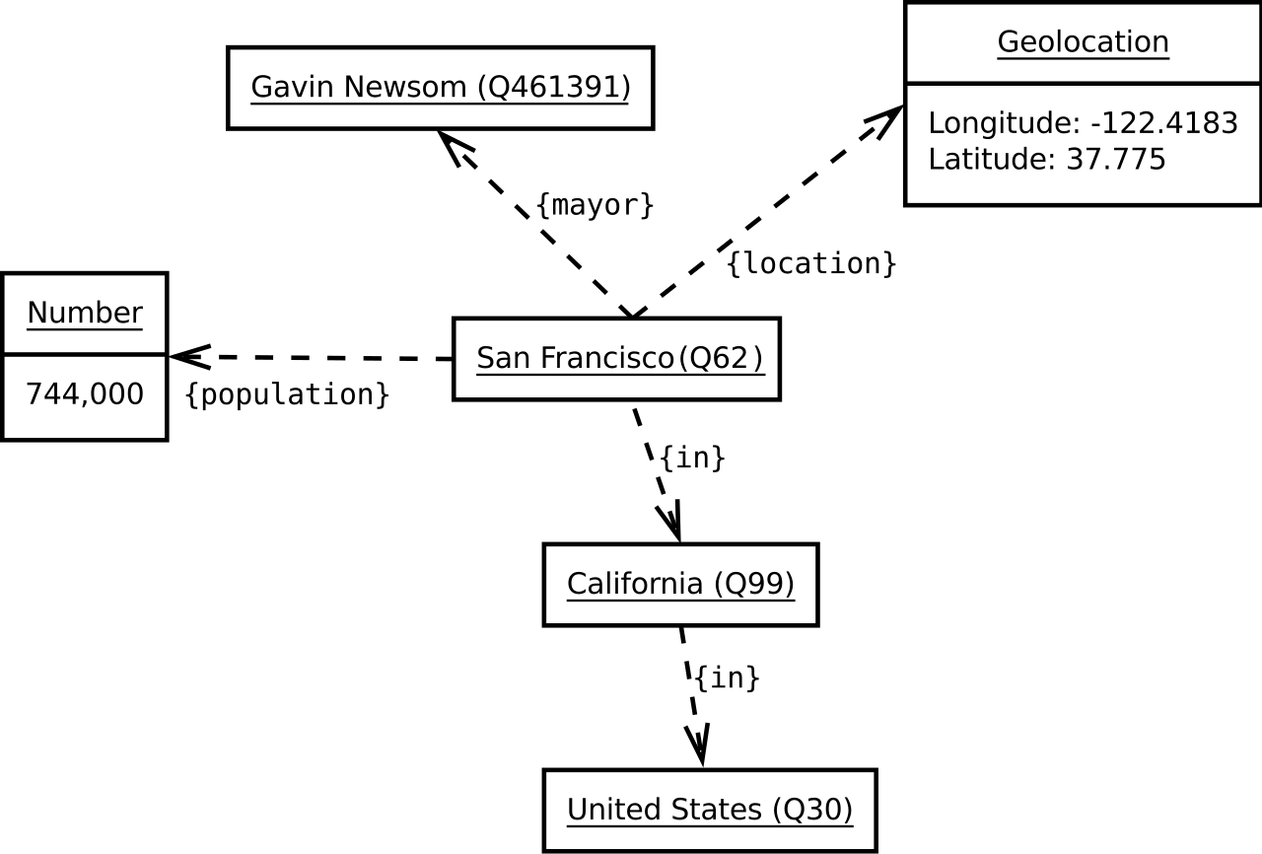
DATA
wikidata
Wikidata.org is a free, collaborative knowledge base for structured data
Data is structures in item-property-value triplets, equivalent to subject-predicate-object.

Slide 6
THE END

